Slide 1
Why Play?
IUSD Professional Learning Summit on
Teaching and Learning!
February 11, 2019
https://tinyurl.com/yyujlpxy
Notes:
This is your welcome page to show as participants enter the room. Be sure to list any preparation instructions here if you need them to log-on or prepare for your session.
Here are some tips for you as you plan and deliver your presentation:
If you are presenting in Session 1, take a moment to orient people to the Sched program to show how they can make a bookmark, create a resource folder or get back to event resources in the future.
Greet attendees at the door and mingle while they are entering. Get to know your audience a bit prior to starting your session - you’ll be surprised at how much more at ease you feel if you visit with your audience before you start presenting!
Play upbeat music as people enter your room! This is one of the easiest ways to change the mood and inject energy.
As you plan your presentation, make sure there are hands-on activities and live demos for your participants. Resist the urge to just show slides or to cover as much content as possible. Encourage attendees to play, try, fail, support each other, and get hands-on with your content. This is what they will remember when they leave your session!
Remember to mute your notifications, emails and chats on your computer before you begin. :)
Smile and have fun!! These are the people with whom you work every day - they want to learn from you and with you today!
For more tips from Ed Tech Team seasoned presenters, visit this link with short videos: ProTips

Slide 2
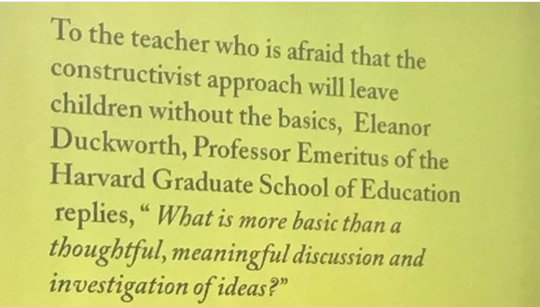

Slide 3
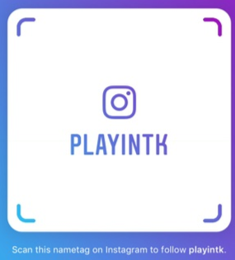
Ready to PLAY?
Your guides…
Jessica Young
Jennifer Herman
jessicayoung@iusd.org
You can find me on
jenniferherman@iusd.org
Instagram @playintk
https://tinyurl.com/yyujlpxy
Notes:
If you repeat the link to your presentation materials on the first five slides, late participants can continue to have access to the link even while you progress through your slidedeck.

Slide 4
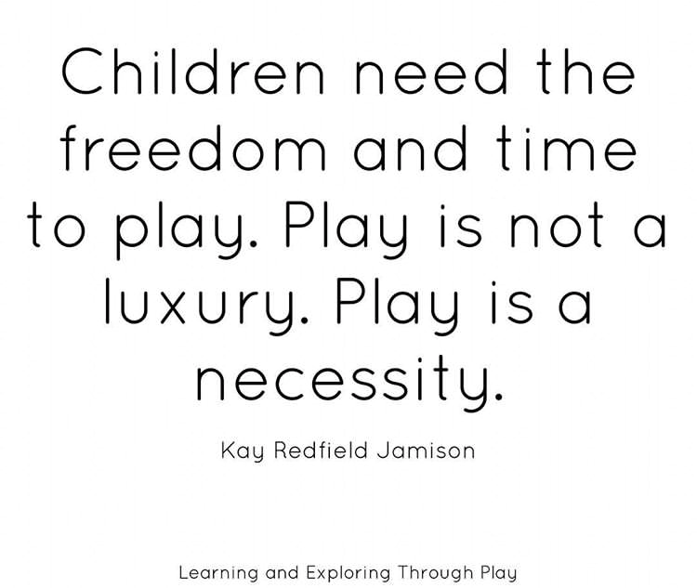

Slide 5
Play
It’s the time when people share and when they get to play with each other.
That I can share my toys… sometimes.
Sharing with friends!
To have fun!
You get to have fun together.
Be happy!
You can play with other friends!
Playing with your friends with toys and playing with new friends.

Slide 6
What is Play?
Discuss…
As you can tell there are many different answers to a seemingly easy question.
We do know that play…
Can be SPONTANEOUS, Recreational, and Activity Based
Allows for a GROWTH Mind-Set
Shows a direct link to growth in:
COGNITIVE LEARNING
ACADEMIC SUCCESS
PHYSICAL HEALTH
SOCIAL-EMOTIONAL DEVELOPMENT

Slide 7
Properties of Play from Saving Play
1. Play is apparently purposeless
2. Play is voluntary
3. It has inherent attraction
4. Provides freedom from time
5. We experience diminished consciousness of self
6. It has improvisational potential
7. It provides a continuation desire
tinyurl.com/yyujlpxy
Notes:
Sample template slide layout to use as needed - there is no order suggested or implied!
Slides 6 - 12 are simply different layouts for you to use as needed depending on the content that you need to display. If you select the Slide tab, Apply Layout pull down menu, you can view all the possible slide layout options that come with this template.

Slide 8
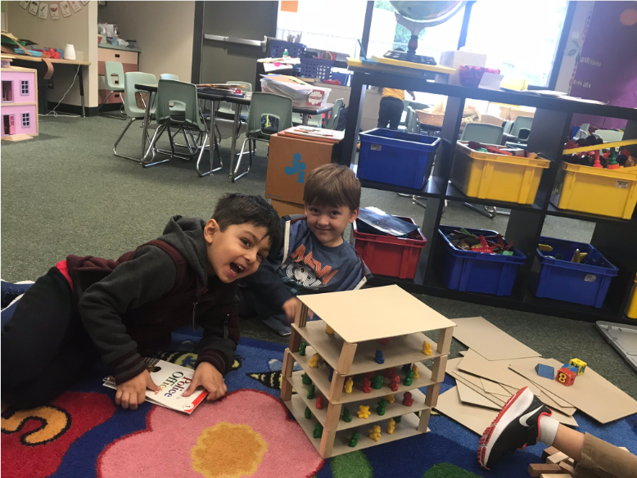
Apparently Purposeless Play?
As a student is playing for fun, the learning does not stop!
New vocabulary is introduced and used.
Using prior knowledge to create connections
Play promotes flexible thinking
Notes:
Sample template slide layout to use as needed - there is no order suggested or implied!

Slide 9
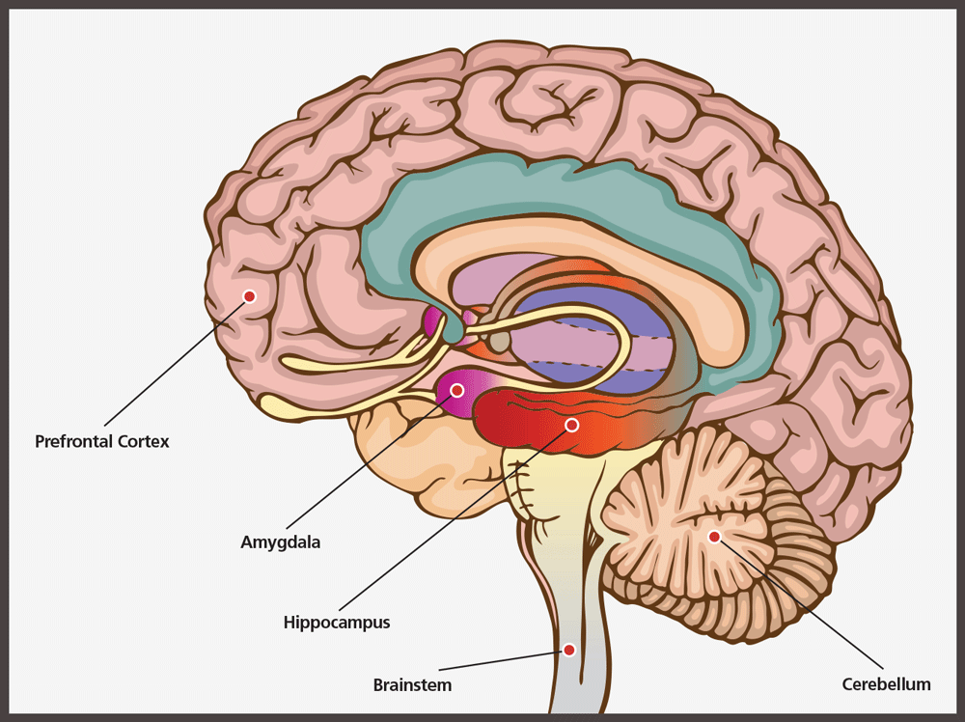
Play & Brain Development
Research over the last 50 years shows that…
A child’s brain is plasticity and malleable
Greater connections/ growth comes from complex interactions
When a child is engaged in complex and active play
neural connections grow stronger
Growth is found in two main areas of the brain
Prefrontal Cortex
Amygdala
Play uses the Pre-Frontal Cortex and Amygdala at the same time
Notes:
Sample template slide layout to use as needed - there is no order suggested or implied!

Slide 10
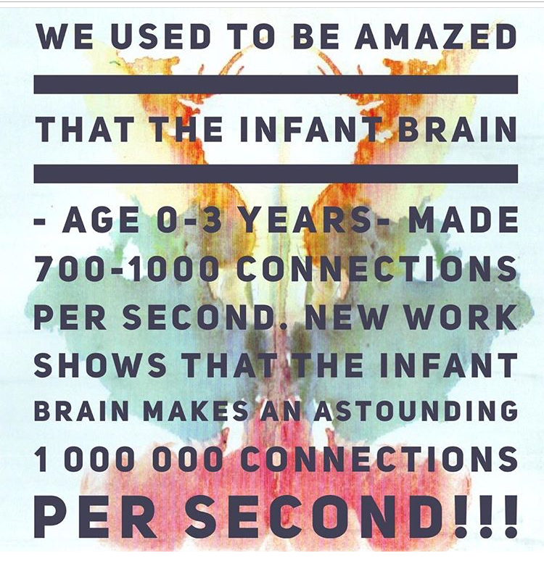
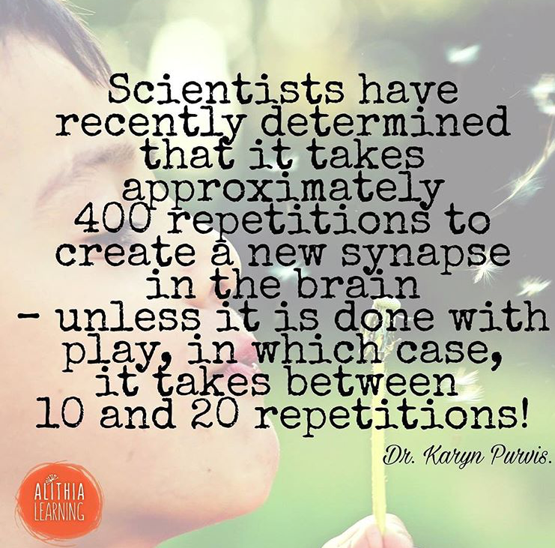

Slide 11
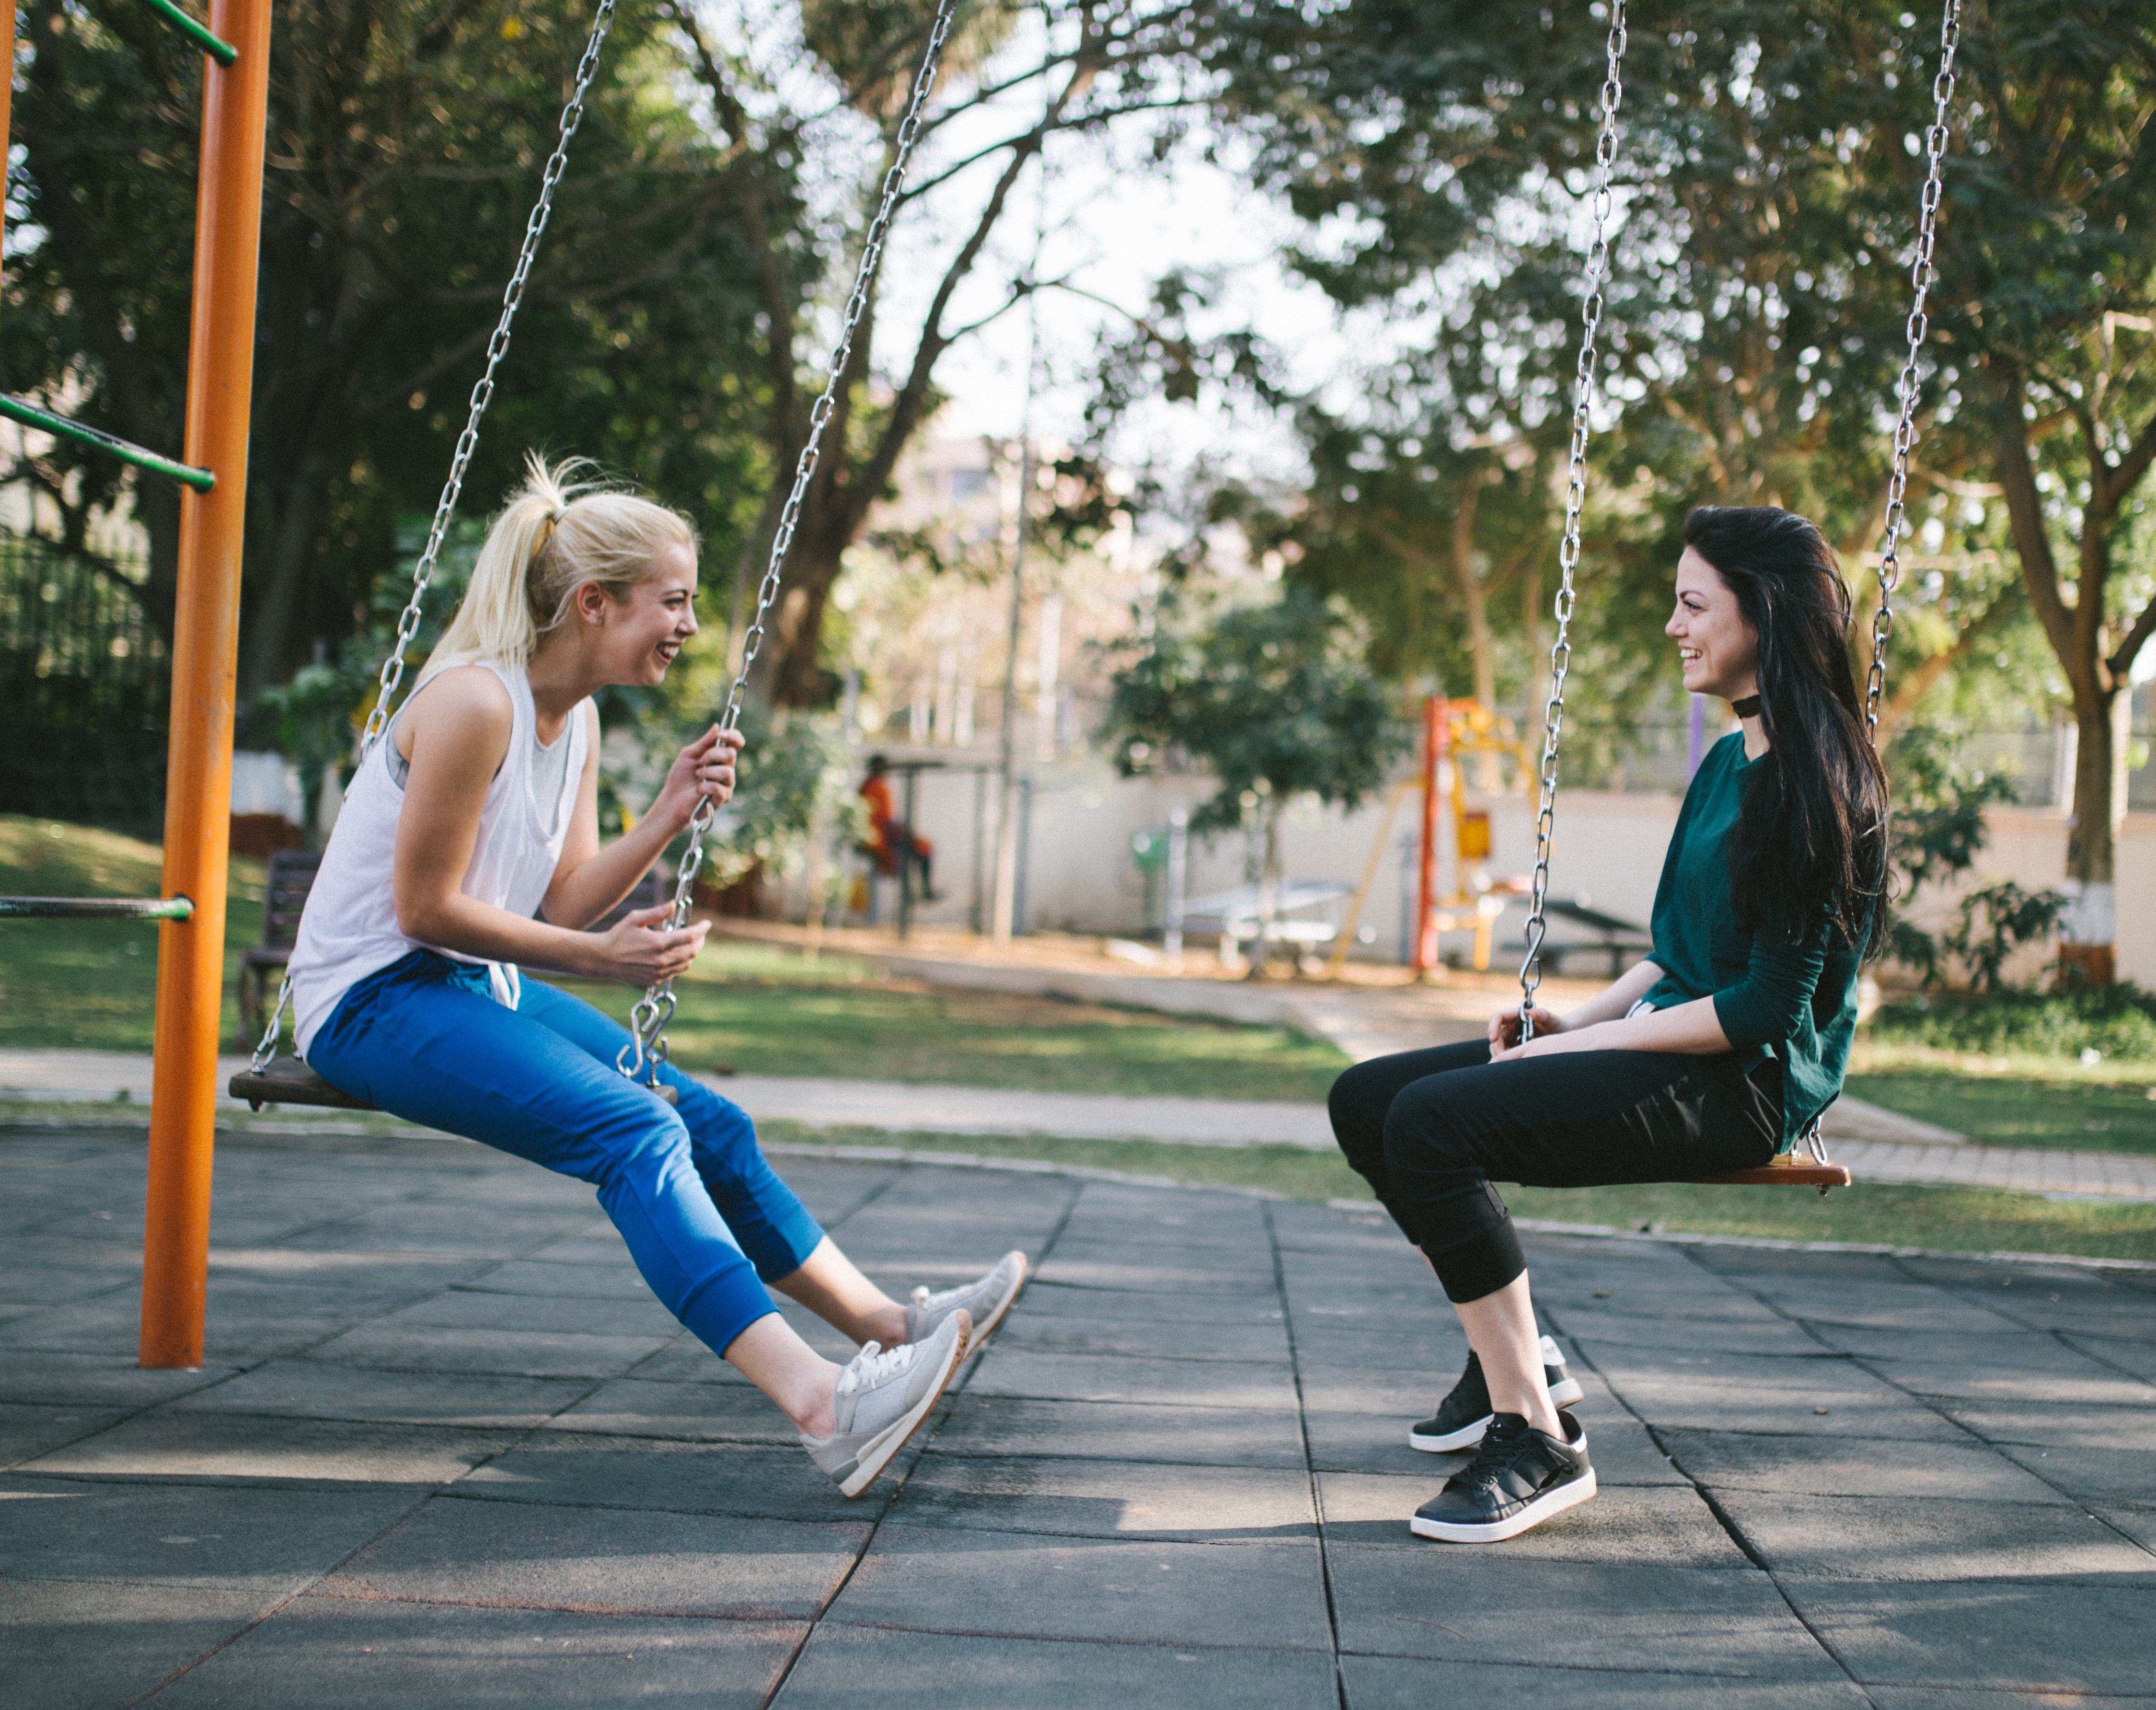
Discussion…
Think back to when you were little and playing.
What type of activities do you remember?
What do you think you learned from those activities?
What are some of the benefits of having opportunities for play in the classroom?

Slide 12
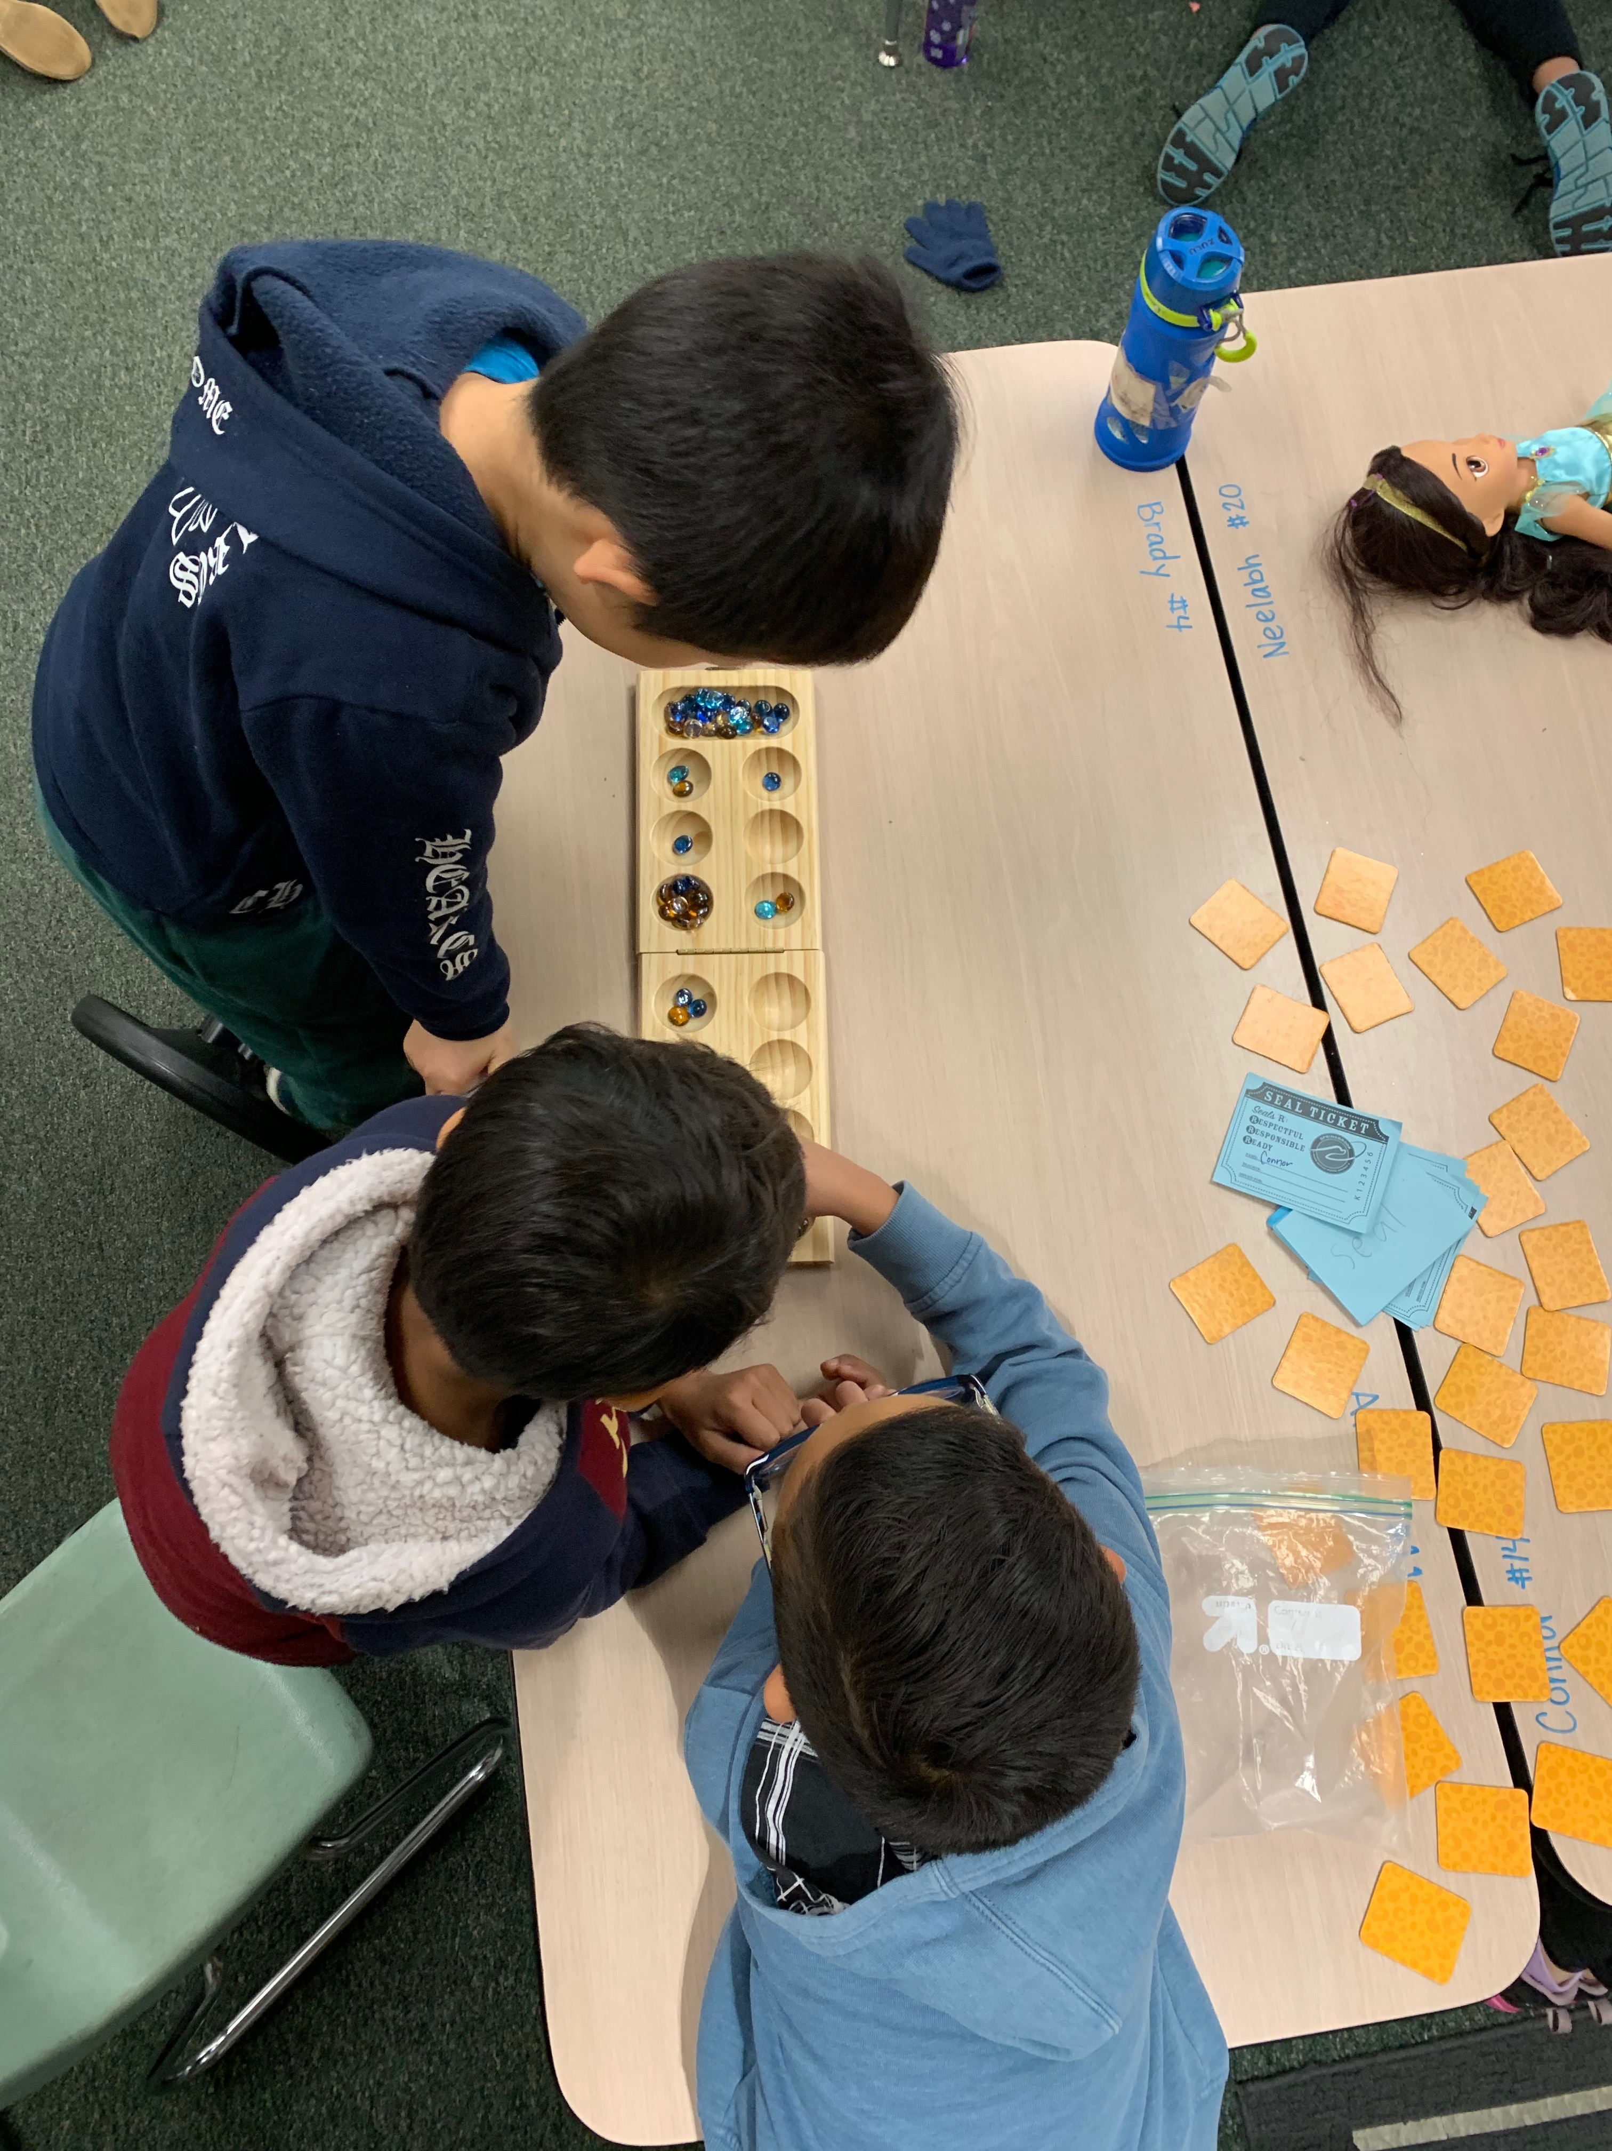
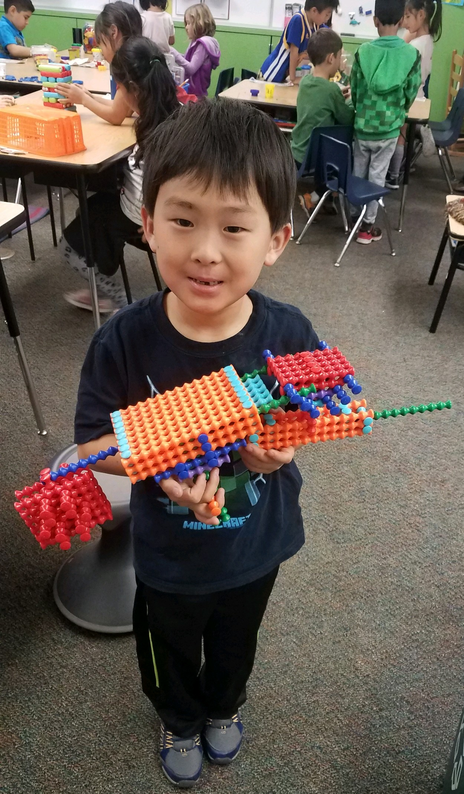
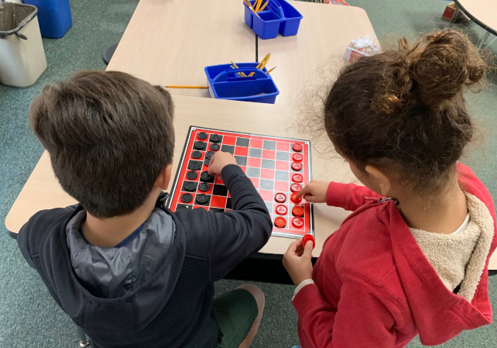
Free Play
Free Play is not truly free play!
Teachers actually plan for free play
Classroom environment
Materials

Slide 13
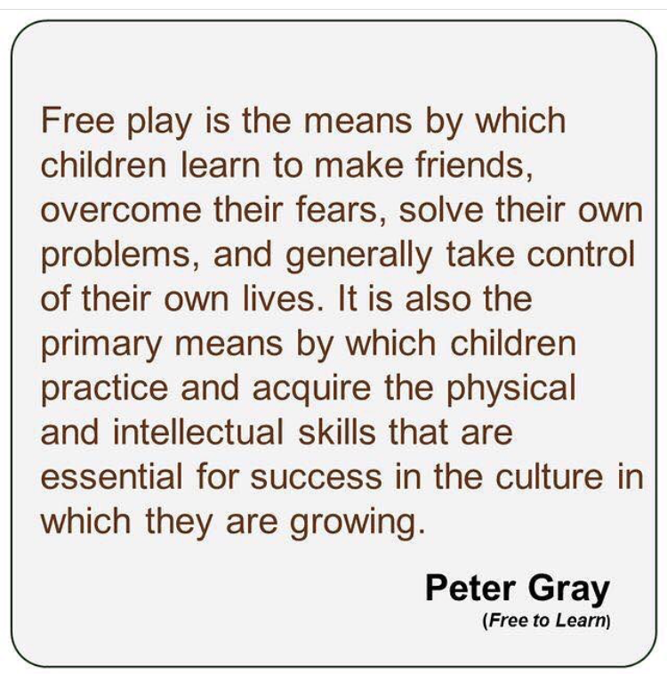

Slide 14
Playful Learning
Playful Learning
Teacher facilitates and guides learning through play
Whole-child approach to education
Still child directed
Understands that children learn through a variety of experiences and approaches

Slide 15
Playful Learning
Playful learning can be
Challenging
Pushes students to work harder
Promotes a deeper understanding of concepts

Slide 16
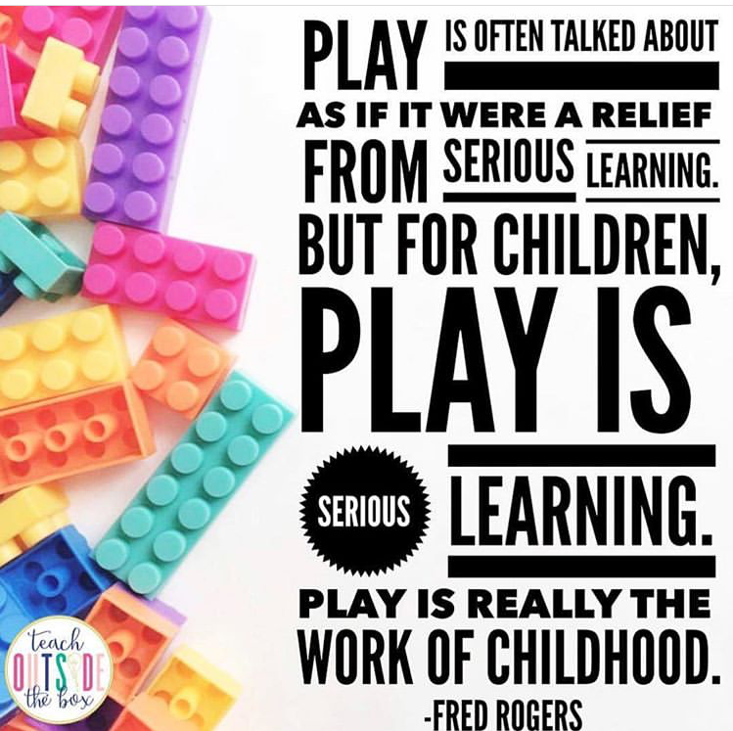

Slide 17
Fitting Play into the DAY!
1. We need to ensure that play experiences are well planned
2. Carefully facilitated and observed
3. Addresses multiple Common Core standards
We may have situations where we need to prove WHY play.
To get play into our classrooms we need to show evidence that students who play have better outcomes than a student using a worksheet ever could!

Slide 18
How to Meet Those Standards
Writing
“Write Letters or letter-like shapes to represent words or ideas.” Preschool Foundations
“Students draw, dictate and/or label drawings to express ideas.” TK Standards
“Uses a combination of drawing, dictating, and writing to compose pieces (including opinion, informative/ explanatory texts, or narratives) of a single event or several loosely linked events.” Kindergarten Common Core

Slide 19
Name Those Standards!

Slide 20
Ready to Play? Easy as 1-2-3-4
1. Identify the standard(s) to be addressed
Ask yourself: does this standard naturally lend itself to child directed play?
Ask yourself: does the play experience provide multiple ways to show understanding of standard?
If the answer is NO to either of those questions, this may not be the best standard for play.
2. Identify the materials needed
3. Chose strategies
4. Determine how to gather assessment info

Slide 21
Great Articles About Play!
What is Happening to Fine Motor Development?
https://preview.tinyurl.com/y3jubpsd
Keep Them Passionately Curious
https://preview.tinyurl.com/yyggnjnv
Pediatricians Say Kids Need Simple Toys, Not iPads And Electronics
https://preview.tinyurl.com/y52sanl8
“Play” Is Not a Four-Letter Word!
https://preview.tinyurl.com/yyl4463q
Children should learn mainly through play until age of eight, says Lego
Young Minds: The Important Role of Brain Science
https://preview.tinyurl.com/yxnezcxu
https://preview.tinyurl.com/yy7g2gbc
The Decline of Play and Rise in Children’s Mental Disorders
The Beauty of Early Childhood Mathematics: Playful Math = Engaged Learning
https://preview.tinyurl.com/y8lbasyx
https://preview.tinyurl.com/y3dbxp94

Slide 22
Great Articles About Play!
Mathematical Structure and Error in Kindergarten
https://preview.tinyurl.com/y5rsx5q6
Playful Math Instruction in the Context of Standards and Accountability
https://preview.tinyurl.com/y2qqeswy
Academics vs. Play: The False Dilemma That Some Principals Face
https://preview.tinyurl.com/y3475tf2
A Conversation About Play
https://preview.tinyurl.com/y4bkhjyp
It's All About Play!
https://preview.tinyurl.com/zm2787b
Back-to-Basics: Play in Early Childhood
https://preview.tinyurl.com/7ezkm7k

Slide 23
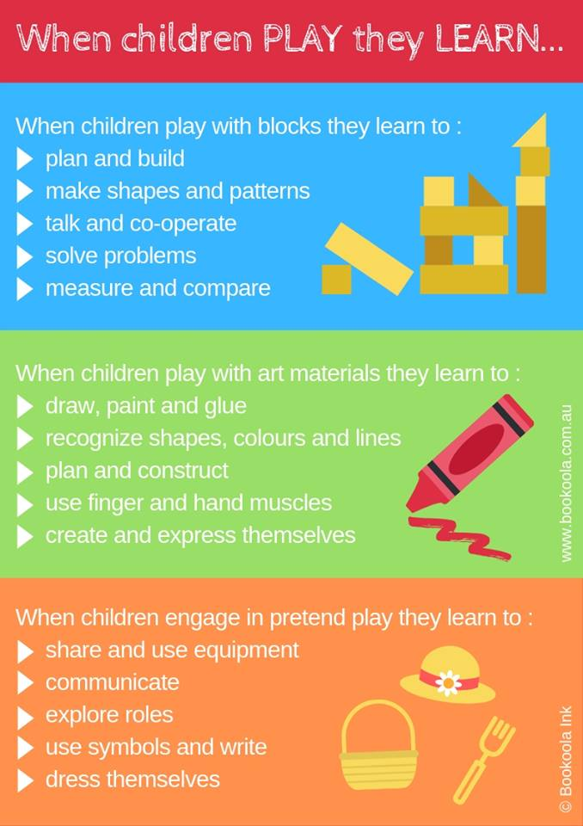

Slide 25
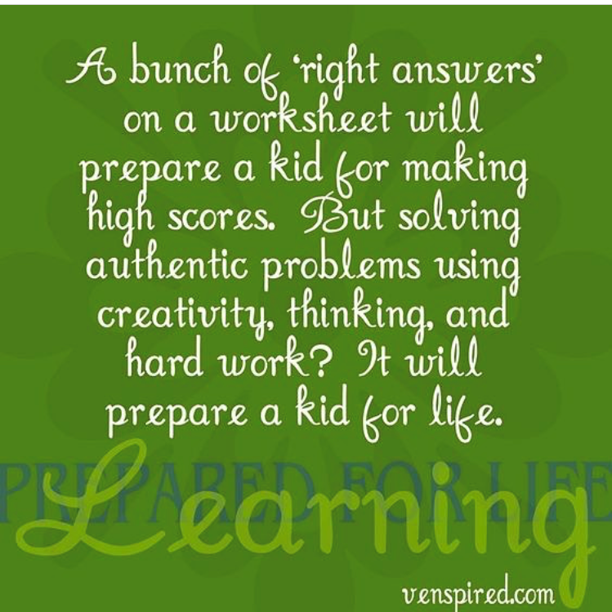

Slide 26
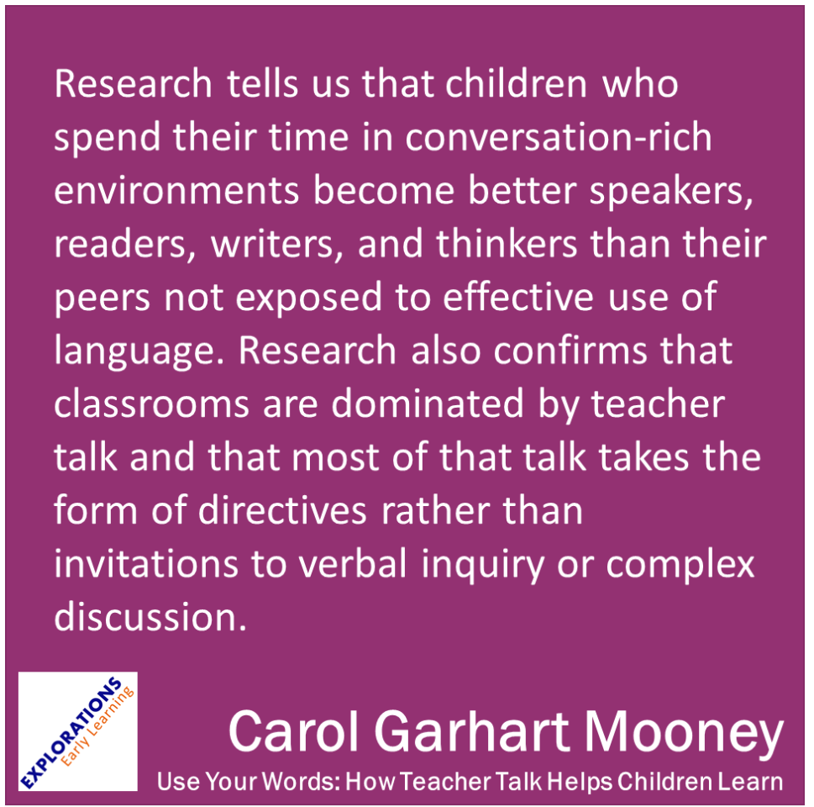

Slide 27
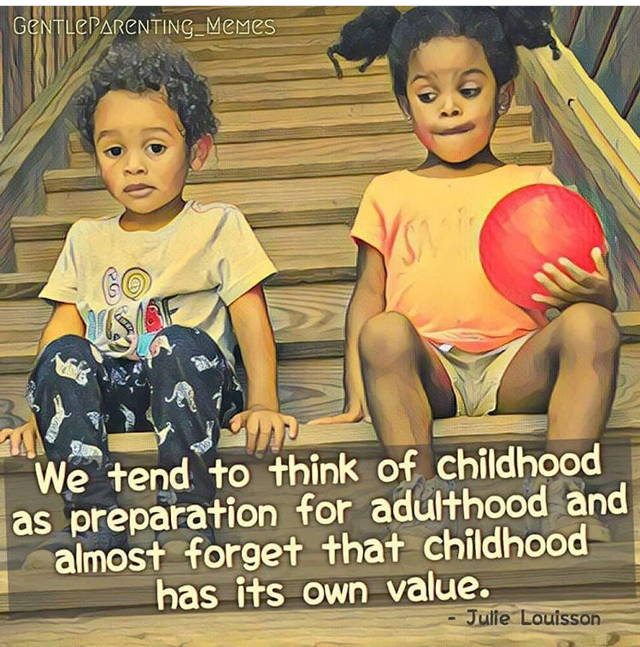

Slide 31
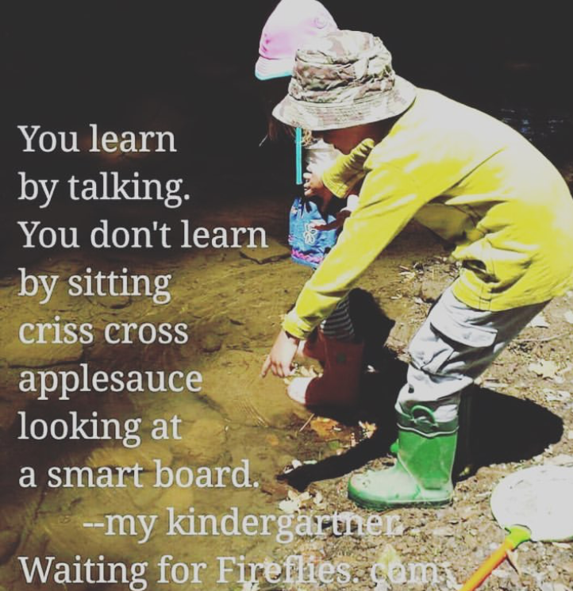

Slide 32
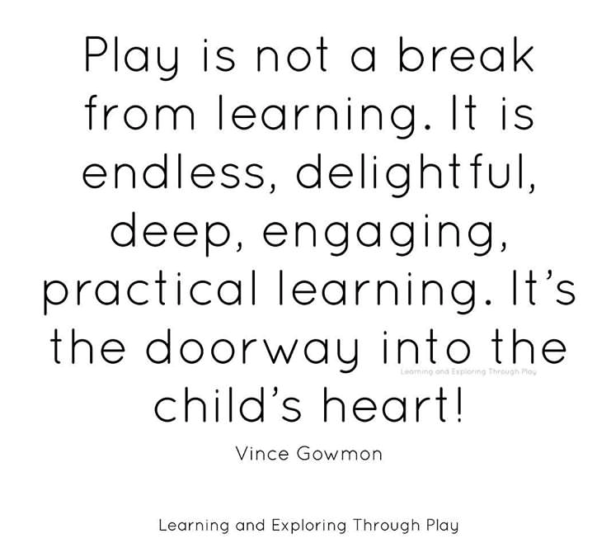

Slide 35
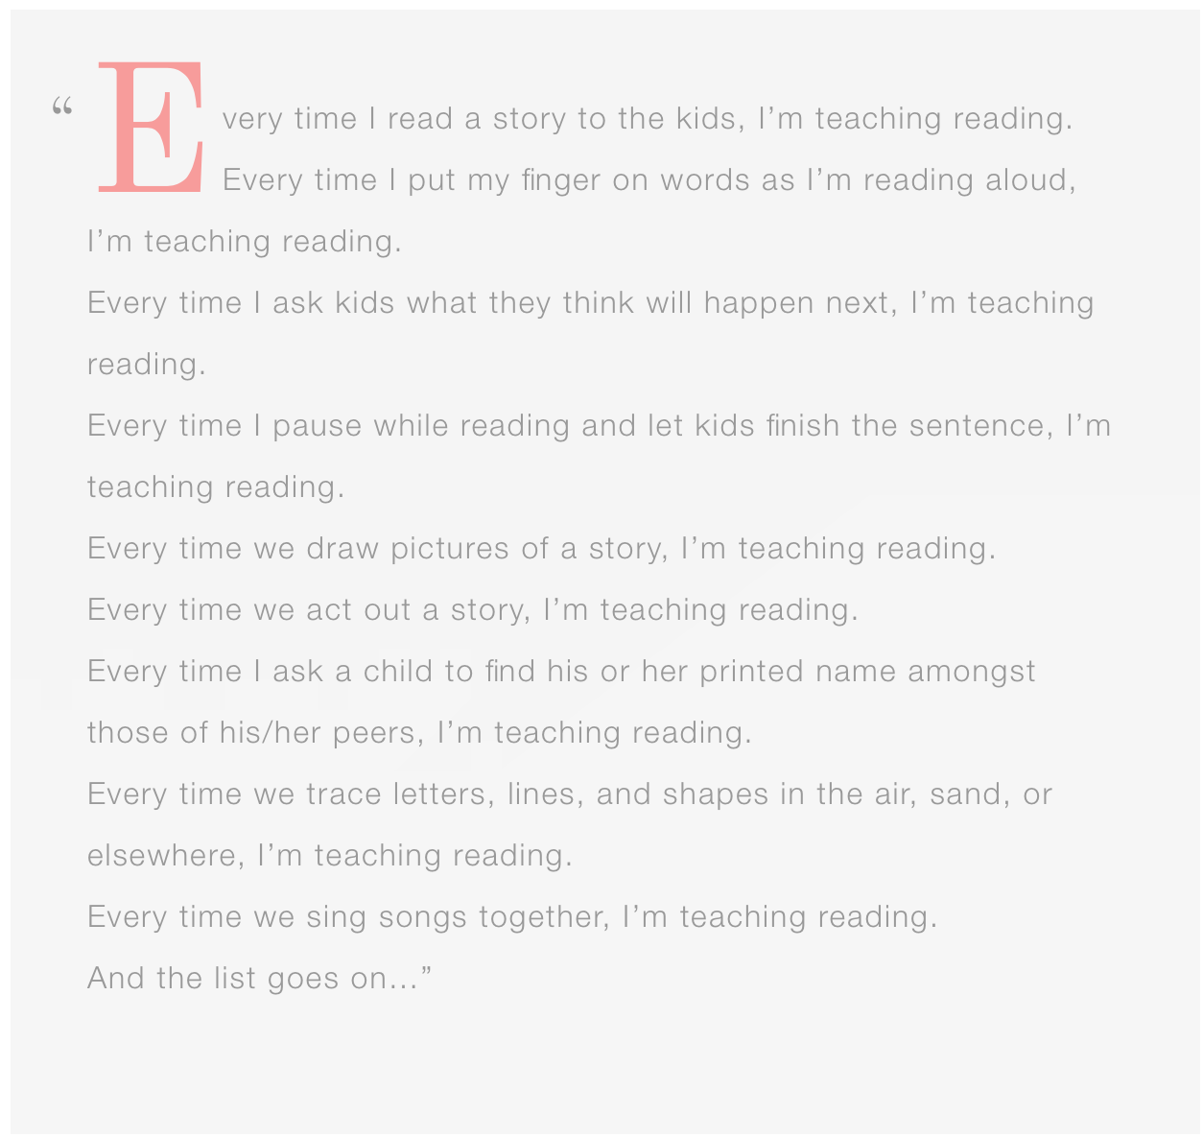

Slide 36
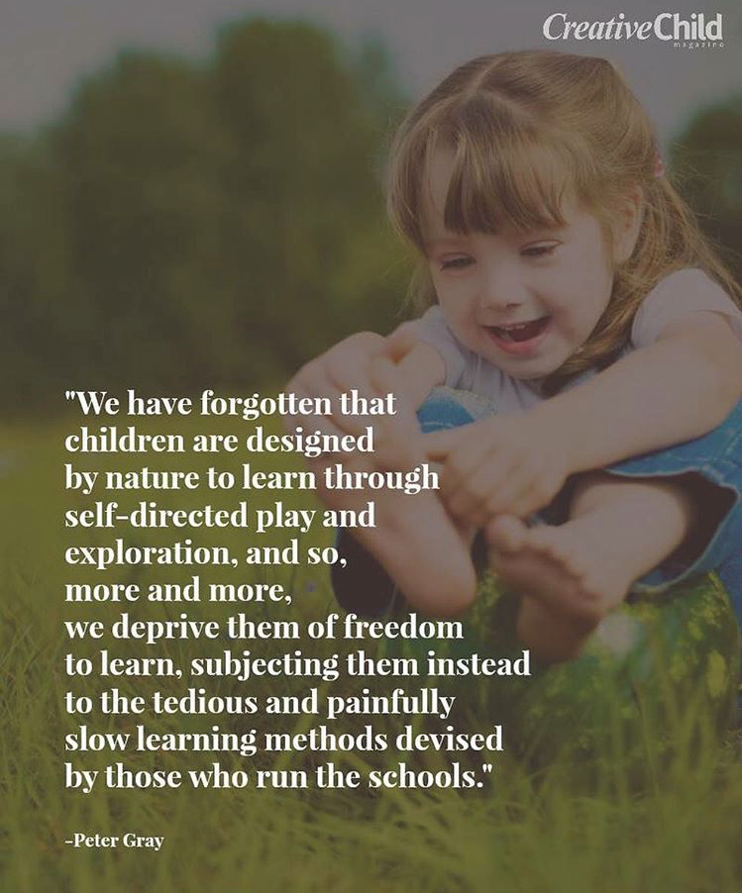

Slide 37
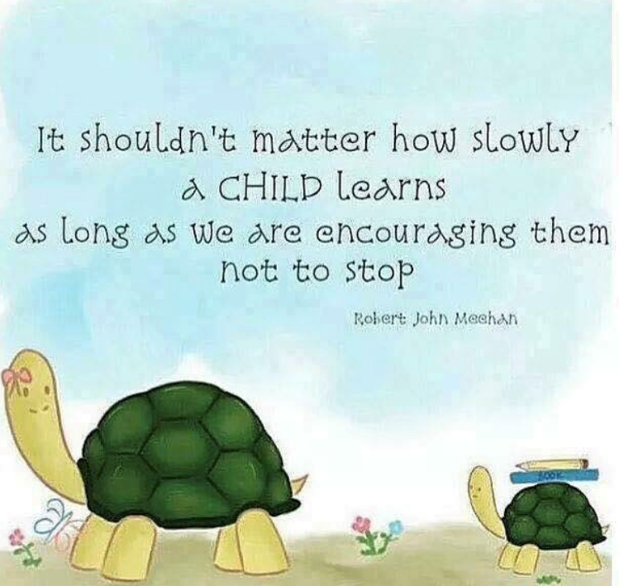

Slide 41
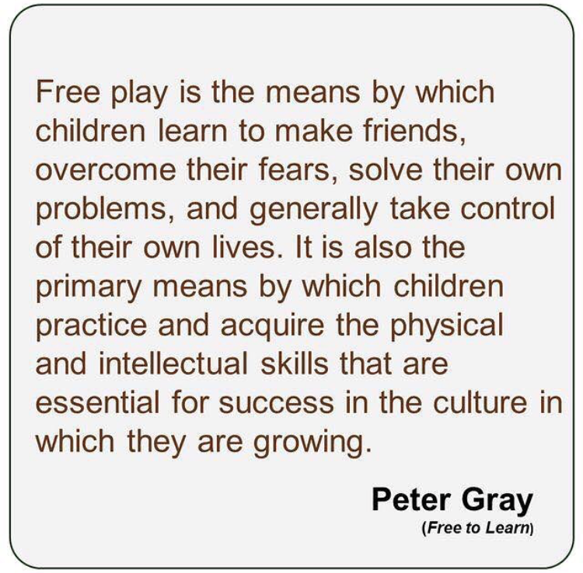

Slide 42
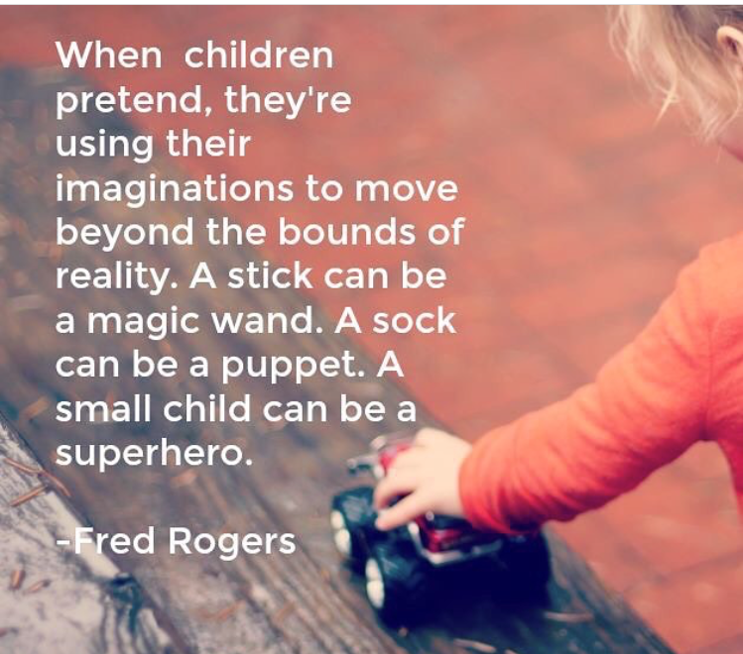

Slide 43
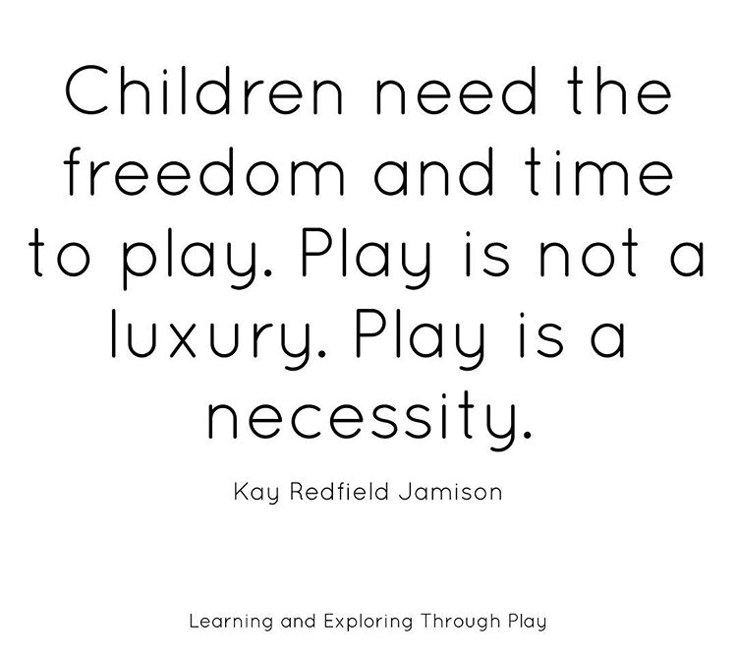

Slide 45
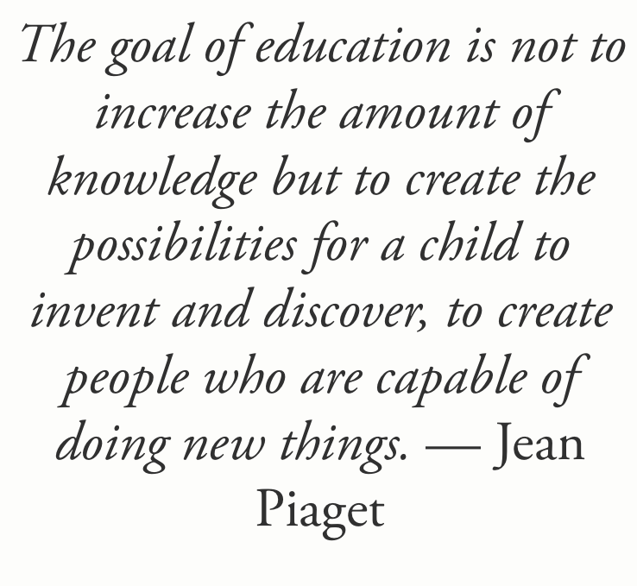

Slide 47
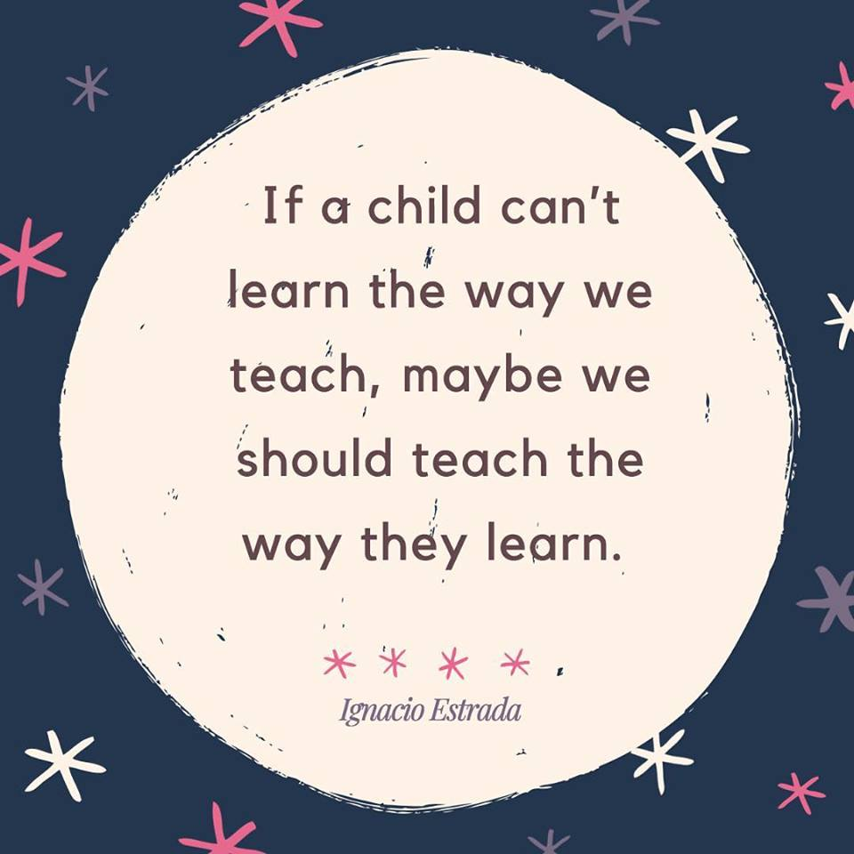

Slide 48
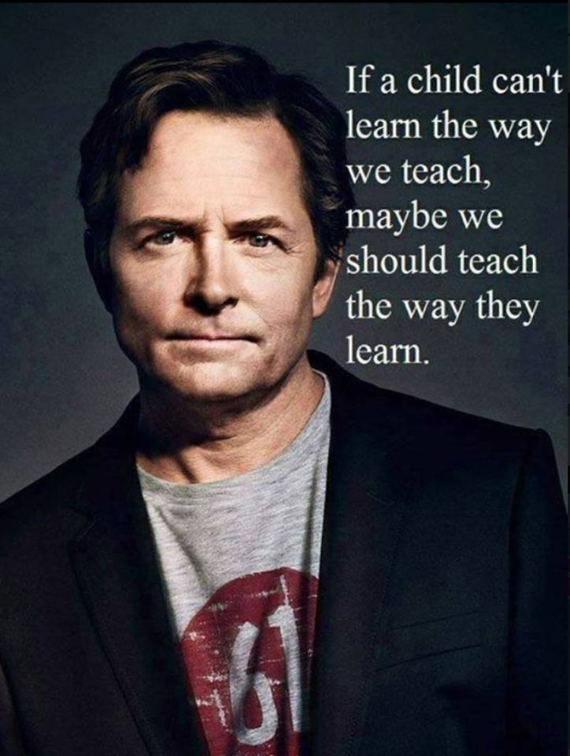

Slide 50
Session Resources
https://tinyurl.com/yyujlpxy
Go to Sched
Find this session WL9
Click on resources

Slide 51
Thanks!
Any questions?
You can find us at jenniferherman@iusd.org and jessicayoung@iusd.org

Slide 52
Credits
Special thanks to all the people who made and released these awesome resources for free:
Presentation template by SlidesCarnival
Photographs by Unsplash

